Slide 1
Tree Traversals
Presented by : Praveen
Faculty Advisor : Dr. Victor Govindaswamy

Slide 2
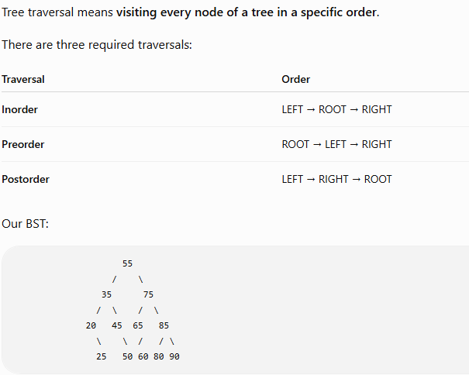
Tree Traversals

Slide 3
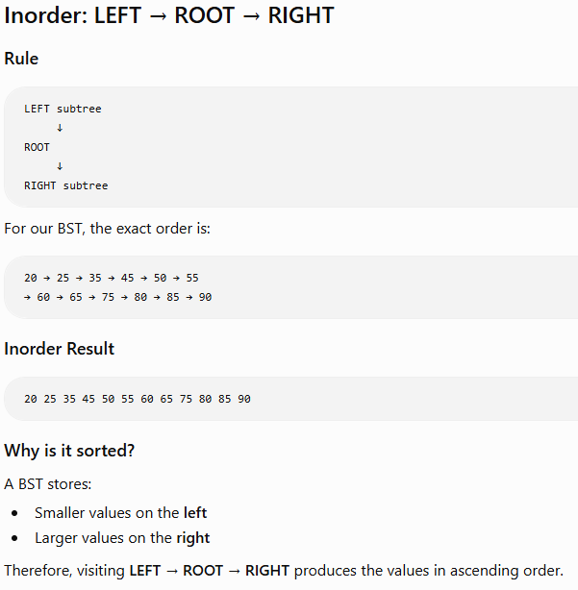
INORDER TRAVERSAL

Slide 4
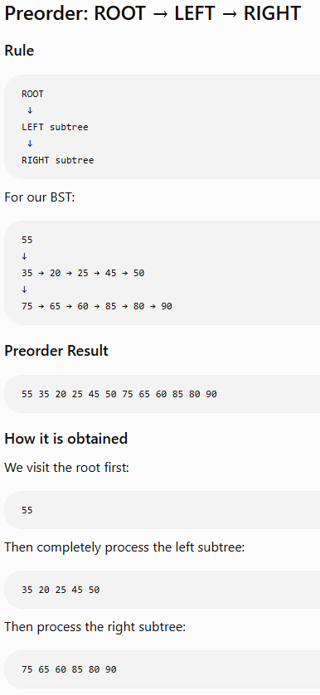
PREORDER TRAVERSAL

Slide 5
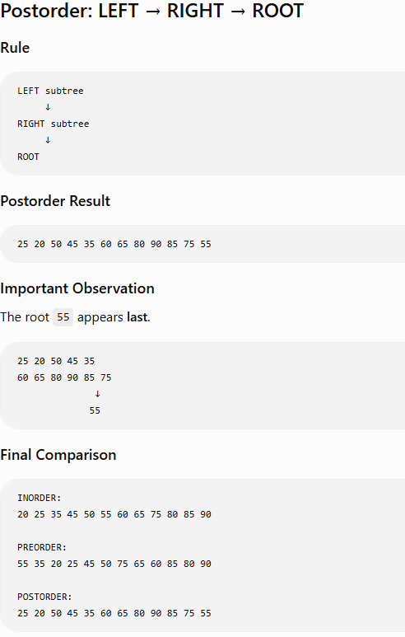
POSTORDER TRAVERSAL

